Slide 2
Learn the basic concept Socket programming.
Understand the process of creating client and server.
Implementation of Socket Programming.

Slide 3
Java Socket programming
Java Socket programming is used for communication between the applications running on different JRE.
It can be connection-oriented or connection-less.
Socket and ServerSocket classes are used for connection-oriented socket programming.
DatagramSocket and DatagramPacket classes are used for connection-less socket programming.

Slide 4
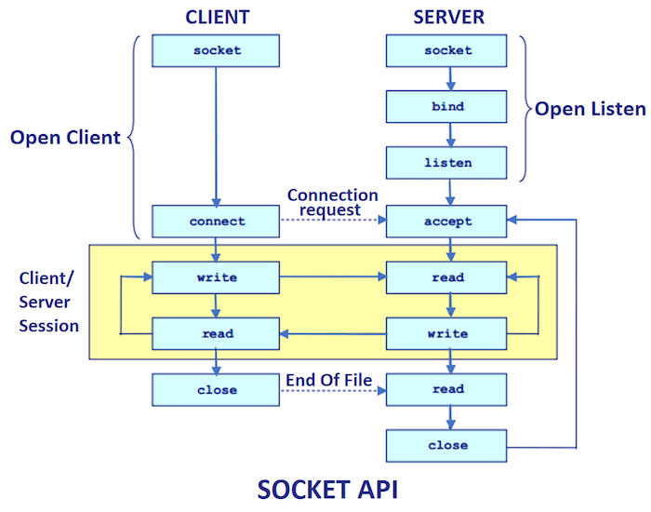
Java Socket programming
The client in socket programming must know two information:
IP Address of Server
Port number.

Slide 5
Creating Server
To create the server application, we need to create the instance of ServerSocket class.
The accept() method waits for the client.
If clients connects with the given port number, it returns an instance of Socket.
ServerSocket ss=new ServerSocket(9999);
Socket s=ss.accept();

Slide 6
Creating Client
To create the client application, we need to create the instance of Socket class.
Here, we need to pass the IP address or hostname of the Server and a port number. Socket s=new Socket("localhost",9999);

